Slide 1


PARTICLE ANALYSIS USING VISION AND MOTION TOOLKIT
Guided by : MR. DEVVRAT TYAGI
Submitted by : SURYANSH SINGH (1603231196)

Slide 2
PARTICLE ANALYSIS OF AN IMAGE
An Overview:
The approach in this article focuses on methods of image processing and computer vision using pre-defined modules of pattern analysis and image filtering with a user-friendly interface for data calibration The objective of this document is to provide solution to the aforementioned real world problems using National Instruments visual programming language, LabVIEW.

Slide 3
Introduction to Virtual Instrumentation
A virtual instrument consists of an industry-standard computer or workstation equipped with powerful application software, cost-effective hardware such as plug-in boards, and driver software, which together perform the functions of traditional instruments.
Virtual instruments represent a fundamental shift from traditional hardware-centered instrumentation systems to software-centered systems that exploit the computing power, productivity, display, and connectivity capabilities of popular desktop computers and workstations.

Slide 4
Virtual Instrumentation: LabVIEW
LabVIEW (short for Laboratory Virtual Instrumentation Engineering Workbench) is a platform and development environment for a visual programming language from National Instruments.
DATA FLOW PROGRAMING:
The programming language used in LabVIEW, also referred to as G, is a dataflow programming language.
Execution is determined by the structure of a graphical block diagram (the LV-source code) on which the programmer connects different function-nodes by drawing wires.
GRAPHICAL PROGRAMMING:
This type of programing uses graphics, icons and designs rather than writing codes for programing.
The graphical approach also allows non-programmers to build programs simply by dragging and dropping virtual representations of lab equipment with which they are already familiar.

Slide 5
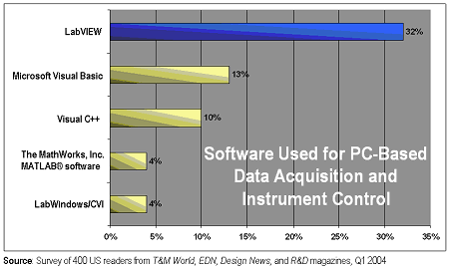
COMPARISON OF LabVIEW WITH OTHER SOFTWARES

Slide 6
INTRODUCTION TO THE PROJECT
This Project presents a system developed using graphic programming on LabVIEW using image processing and particle analysis so as to indicate increase in vehicular density on particularly traffic-prone roads and hence alert necessary officials of the same instantly.
INPUT USING DAQ DEVICE
LabVIEW
THRESHOLD VALUES

Slide 7
SOFTWARE USED
NI LabVIEW : Lab VIEW (acronym for Laboratory Virtual Instrumentation Engineering Workbench) is a platform and development environment for a visual programming language from National Instruments. The graphical language is named "G". Originally released for the Apple Macintosh in 1986, LabVIEW is commonly used for data acquisition, instrument control, and industrial automation on a variety of platforms including Microsoft Windows, various flavours of UNIX, Linux, and Mac OS. The latest version of LabVIEW is version 8.20, released in honour of LabVIEW's 20th anniversary.
NI VISION AND MOTION TOOLKIT : A part of NI Vision Development Module is a library of LabVIEW that one can use to develop machine vision and scientific imaging applications. It enables you to prototype any application strategy quickly without having to do any programming.

Slide 8





FLOW DIAGRAM OF PROJECT
Acquire image from
Road camera.
Perform image processing
using methods mentioned
If ratio is higher than set threshold, alert officials.
Perform particle analysis
on image.
Calculate ratio of total Area
of particles to total area of
Image.

Slide 9
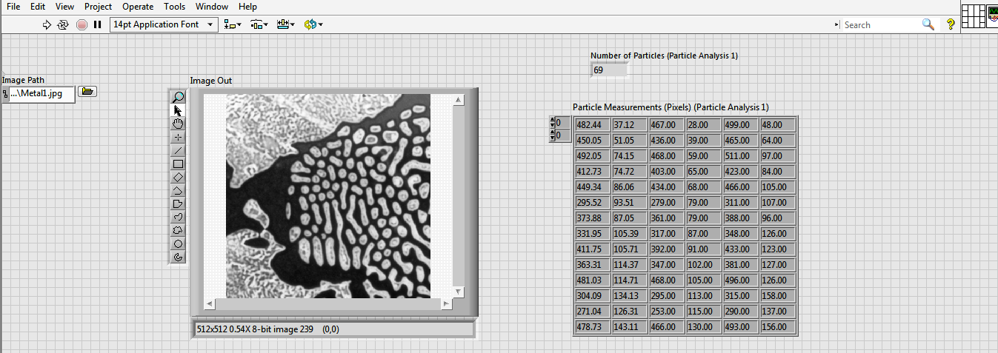
Front Panel Window

Slide 10
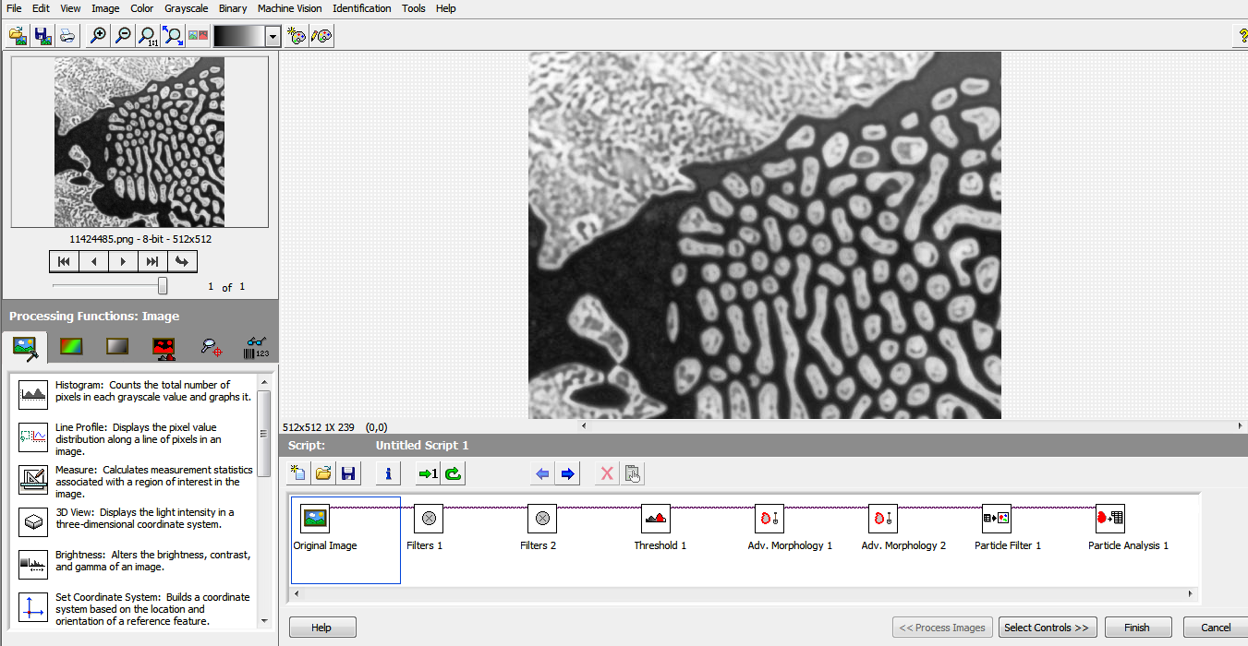
Block Diagram Window

Slide 11
ALGORITHM .
Following are the methods used : 2.1.1 Colour Plane Extraction An RGB image (of three colour planes – red, green and blue) is converted into an 8-bit greyscale image by extracting the information of a single colour plane and discarding all the other elements of the original image. 2.1.2 Image Reversal This is a particular toll in the greyscale image tab which operates on 8-bit greyscale images only. This method involves inverting the intensity of gray in the images. Greyscale involves an image of varied intensities. 255 for white and 0 for black. 2.1.3 Greyscale Thresholding This method involves conversion of a greyscale image to a binary image with respect to a threshold value manually chosen using a scroll-bar on the tool in LabVIEW. The threshold is in essence an intensity value. All pixels with intensities above this value is maintained as one colour and all intensities below the value are set as the other colour (Black or Red, according to manual controls on LabVIEW. 2.1.4 Image Masking and Arithmetic Operations These toolboxes consist of arithmetic and logical operations to be performed on the captured images. To provide additional accuracy to the program, images are captured and appropriate logical expressions are created to remove the unwanted parts of the image . This leaves only the images of the desired things in the final output. Now, regions that are not required are masked, i.e. those parts are removed from the image. The final output displays only the desired portion

Slide 12
THANK YOU…
SUBMITTED BY: SURYANSH SINGH
ROLL NO :1603231196

